Slide 1
Verifying Lingua Franca using UCLID5
Shaokai Lin
Group Meeting Presentation
8.28.20

Slide 2
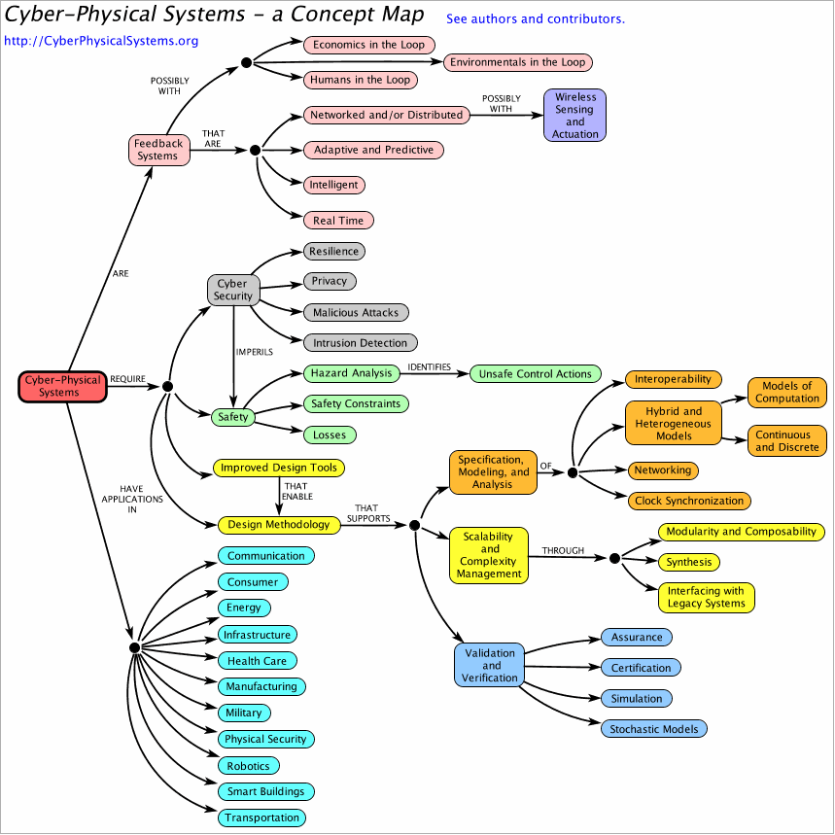
Cyber-Physical Systems (CPS)
Notes:
Logical time: monotonically increasing sequence of tags of the form (a, b), where a is referred to as the time value and to b as the microstep index.
Physical time: time value that is obtained from a clock on the execution platform.

Slide 3

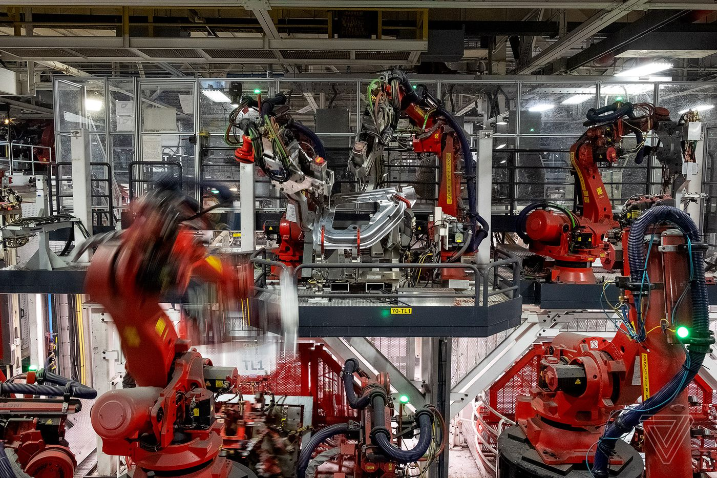
Cyber-Physical Systems (CPS)
Notes:
Logical time: monotonically increasing sequence of tags of the form (a, b), where a is referred to as the time value and to b as the microstep index.
Physical time: time value that is obtained from a clock on the execution platform.

Slide 4
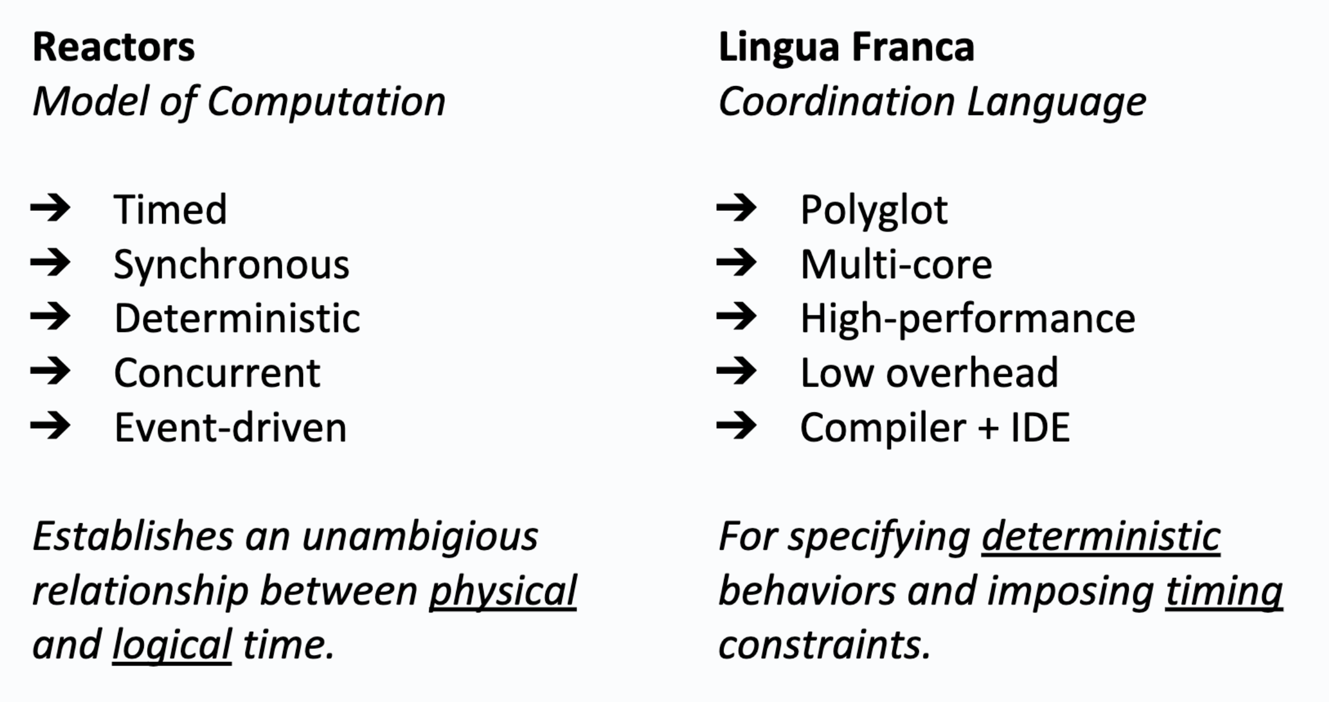
Reactors and Lingua Franca (LF)
Github: https://github.com/icyphy/lingua-franca
[Lohstroh et al., 2019]

Slide 5
Verifying Cyber-Physical Systems
Cyber
Physical
For the cyber part alone, there are a few questions to consider:
Correctness of reaction code
Schedulability
Single-threaded, multi-threaded, distributed executions
Uncertainties (network delay, sensor output, etc.)
Properties related to these questions can be specified using pre/post conditions, and Linear Temporal Logic (LTL).

Slide 6

Train Door Example
Mode 1:
Door unlocked,
Train stopped
Press button
Mode 2:
Door locked,
Train moving
What if Controller, Train, and Door are separated by a network?
Unsafe state: unlocked & moving

Slide 7
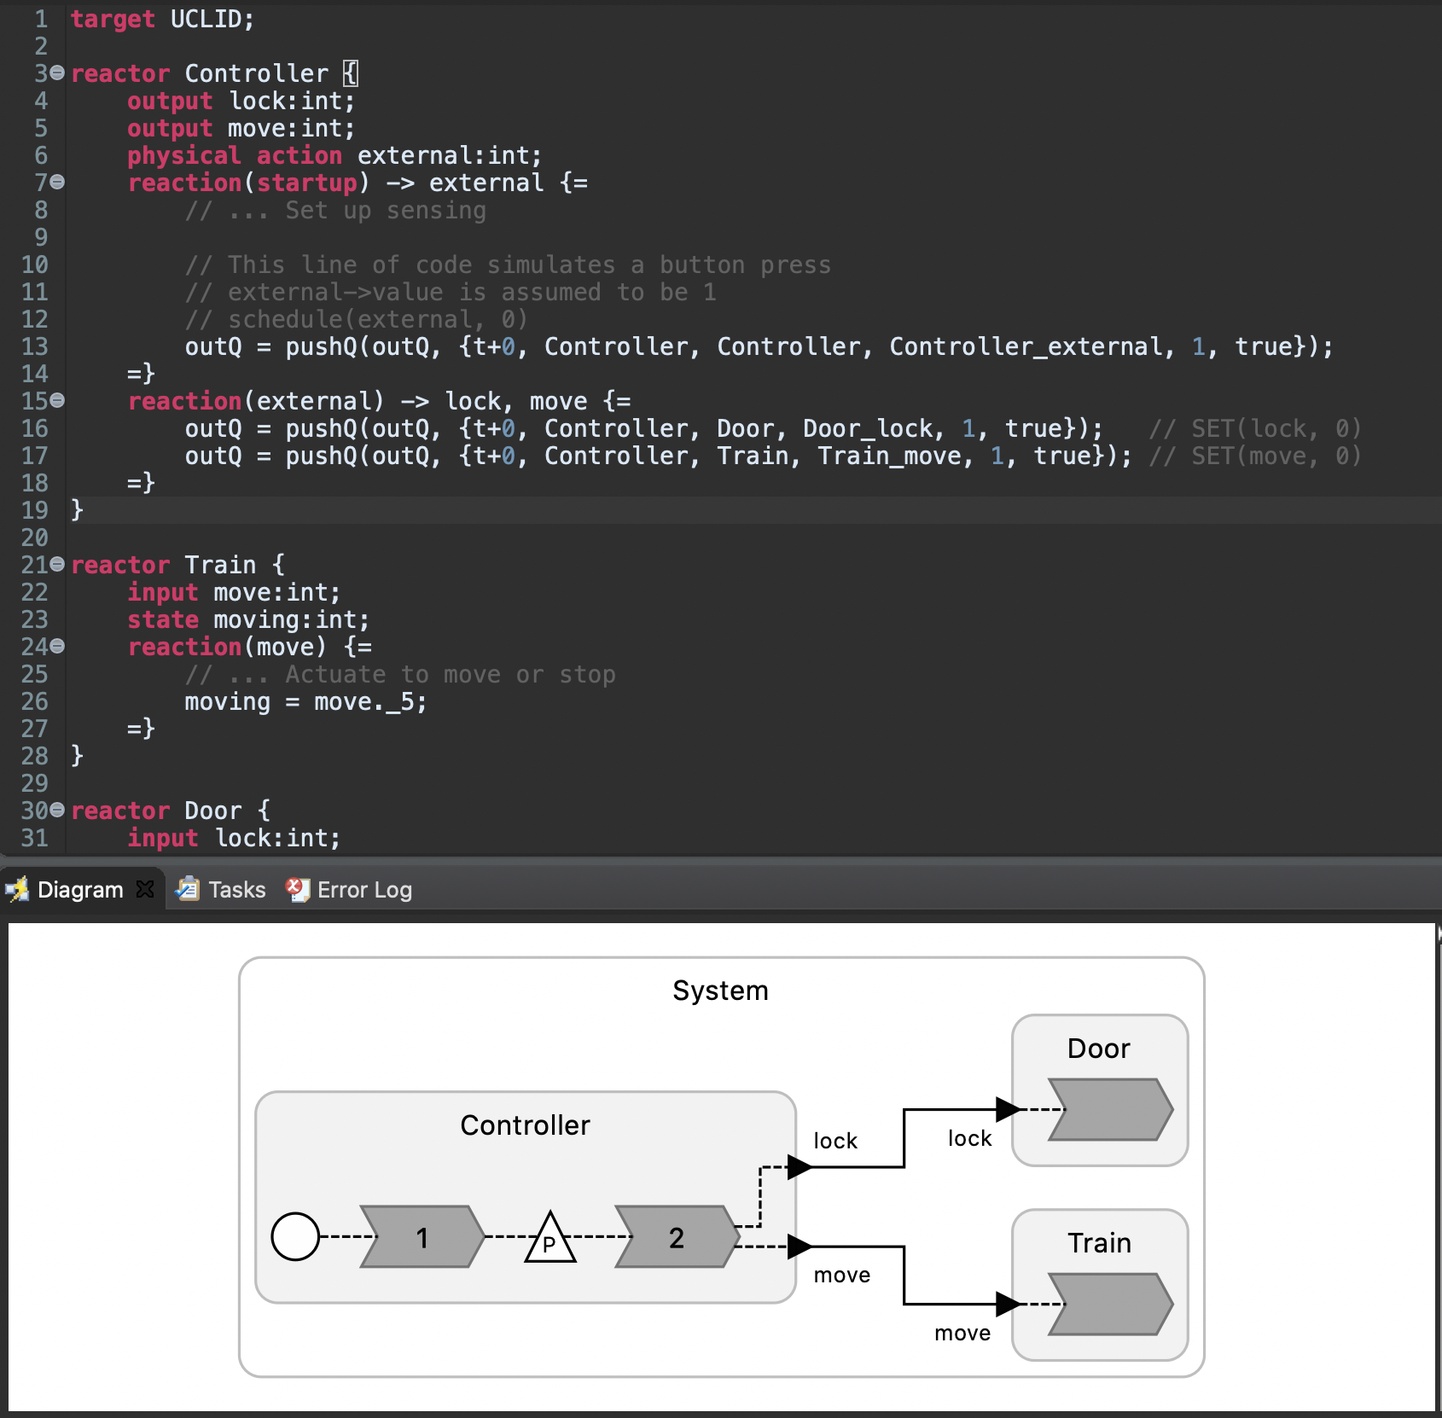
TrainDoor.lf

Slide 8
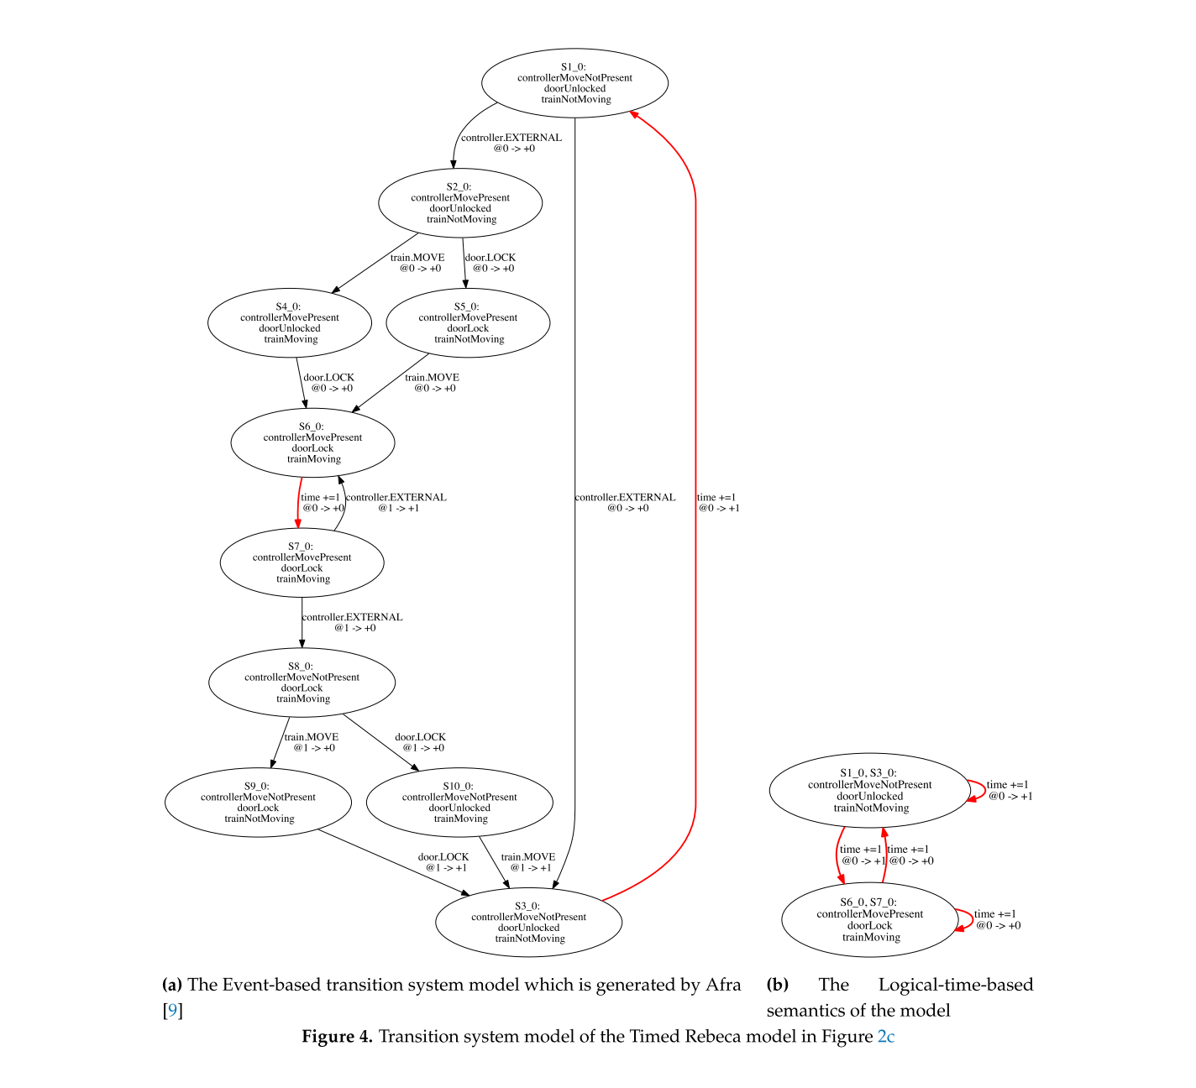
Semantics
[Sirjani et al., 2020]

Slide 9
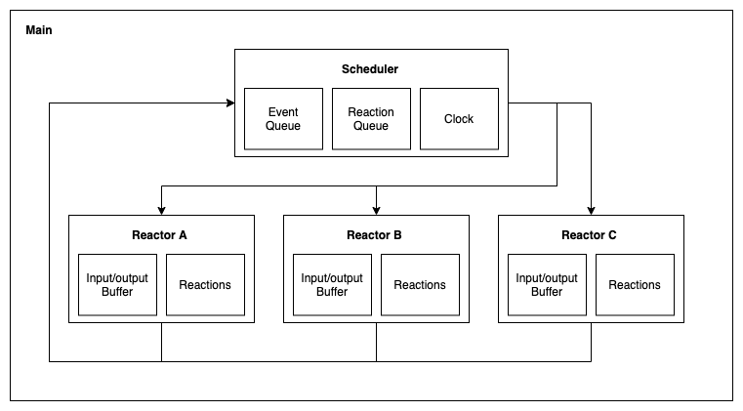
Mapping LF into UCLID5

Slide 10
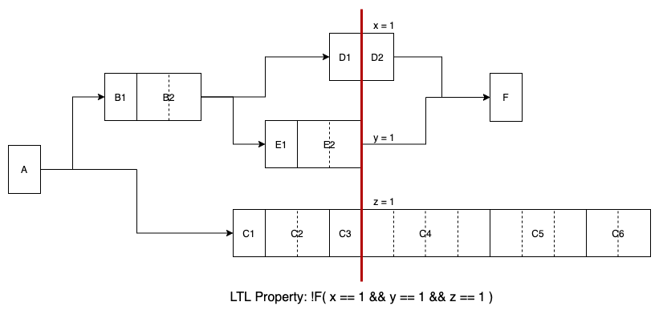
In Progress
Concurrent semantics
To account for more execution environments
To check for subtle unsafe states during concurrent executions
Proof by induction
To obtain unbounded guarantees

Slide 11
Model of Computations
Notes:
Logical time: monotonically increasing sequence of tags of the form (a, b), where a is referred to as the time value and to b as the microstep index.
Physical time: time value that is obtained from a clock on the execution platform.

Slide 12
Actor Model
Notes:
Logical time: monotonically increasing sequence of tags of the form (a, b), where a is referred to as the time value and to b as the microstep index.
Physical time: time value that is obtained from a clock on the execution platform.

